Slide 1
VAT reverse charge for construction services from 1 March 2021
Richard Taylor

Slide 2
Areas to be covered
Overview
Services covered by Reverse Charge
Deciding if the Reverse Charge applies and examples
Simplifications and areas to be aware of
Invoicing including examples
Transitional arrangements
Accounting – Sage & Xero

Slide 3
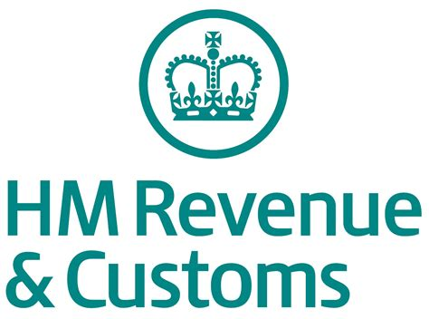
How does it work – VAT “payments”
Currently
End User
Reverse Charge
End User
VAT of £X
VAT of £X
Recipient of construction services (not end user)
VAT of £X
Recipient of construction services (not end user)
VAT of £X
VAT of £X
Supplier of construction services
Supplier of construction services

Slide 4
What services are covered
Services that fall within the scope of CIS, including:
constructing, altering, repairing or demolishing buildings or structures
constructing, altering, repairing or demolishing any works forming, or to form, part of the land, including, e.g. walls, roads, civil engineering works
Installing heating, lighting, air-conditioning or similar systems in a building or structure
internal cleaning of buildings and structures if part of construction, alteration or repair work
internal or external painting or decorating of buildings or structures
Services which are integral to the services listed above including site clearance, earth-moving, laying of foundations, erection of scaffolding, site restoration, landscaping etc

Slide 5
What services that are not covered:
Services of professionals such as architects
Supplies of staff rather than construction services , e.g. by employment businesses – key here is who has control over the workers and is responsible for work carried out
Legislation does list various other works not covered, including installing:
seating, blinds, shutters, security systems,
burglar alarms, closed circuit television and public address systems
artistic works such as sculptures
Zero-rated services
Supplies of goods only – e.g. purchases from builders merchants

Slide 6
Labour only construction services
These are covered by the new reverse charge and have the following features:
Customer engages a business to carry out specified work
labourers are employed by or engaged by the supplying business
supplying business provides a price for the works or agrees a measured rate per square metre
supplying business is responsible for the labourer’s works and is responsible for correcting any defects following completion of the works
customer, or its representatives, agrees that the work has been carried out or certifies payment for the value of works carried out to date

Slide 7
Services supplied by employment businesses (supplies of staff)
These are not covered by the reverse charge and have the following features:
the customer contacts the employment business and asks for X workers for Y days
the workers are employed by or engaged by the employment business
the employment business provides an hourly or daily rate for the workers
a timesheet is used to record the hours and days worked
the customer sends the signed timesheet agreeing the hours and days worked to the employment business
the customer pays the employment business
the customer’s site foreman or managers direct and control the works carried out by the workers
the customer is responsible for the works carried out

Slide 8
VAT reverse charge for construction services – End Users
End User – a recipient of specified services who does not make an onward supply of the building and construction services supplied to them.
Developers selling new buildings would be end-users as they are not resupplying the construction services but are selling buildings. Main contractors constructing buildings for the developer are not end-users as they would resupply construction services they receive as part of their charge for construction services to the developer.
Intermediary supplier (relevant intermediary)– connected to an end user, either by being in the same corporate group or by having a shared interest in the land, e.g. for example, landlord and tenant, where the works are taking place, and will make an onward supply of the construction services to the end user without material alteration or further processing.

Slide 9
End users confirmation
Has to be in writing, this can be:
On paper
Electronically in an email
In a contract which is signed or has been agreed in writing
The notification has to show what supplies are covered, e.g. by mentioning site or a quote etc
As an example:
We refer to your quote dated 10/04/21 for alteration works to 123 Main Street, Taunton.
We are an end user for the purposes of section 55A VAT Act 1994 reverse charge for building and construction services. Please issue us with a normal VAT invoice with VAT charged at the appropriate rate. We will not account for the reverse charge”
If you often deal with end users your Terms & Conditions can say “you’ll assume that your customer is an end user or intermediary supplier unless they say they’re not”

Slide 10
VAT and CIS registered supplier of services
Ask customer if they are VAT registered
Issue your normal invoice
No
Ask customer if they are CIS registered
Issue your normal invoice
No
Decide if VAT would normally be charged on the work
Issue your normal invoice
No
Does work fall within CIS
Issue standard VAT invoice
No
Ask customer if they are an end user or relevant intermediary
Issue Reverse charge invoice
Yes
No
Issue standard VAT invoice

Slide 11
VAT and CIS registered recipient of services
Reverse charge not applicable, normal invoices should be issued by supplier
Decide if the work would attract VAT
No
Check if supplier is VAT & CIS registered
Reverse charge not applicable, normal invoices should be issued by supplier
No
Decide if the work is covered by CIS
Reverse charge not applicable, normal VAT invoices should be issued by supplier
No
Decide if you are an end user
You should receive a reverse charge invoice without a VAT charge from your supplier
Yes
No
Tell your supplier and they should issue a normal VAT invoice

Slide 12
Examples of how Reverse charge works
Customer VAT regd – Y
Customer CIS regd – Y
VAT chargeable on work – Y
Is service reported in CIS - Y
Customer end user -N
Reverse charge applies
Sub-contractor issues reverse charge invoice for £50,000
VAT and CIS registered sub-contract roofer
Subbie does work of £50,000 for main contactor on shop
VAT & CIS registered main contractor
Customer VAT regd – Y
Customer CIS regd – Y
VAT chargeable on work – Y
Is service reported in CIS -Y
Customer end user -Y
Reverse charge does not apply
Main contractor invoices retailer for £500,00 plus £100,000 VAT
Main contractor contacts with retailer to build shop for £500,000
Retail company who will occupy shop – retailer is end user

Slide 13
Examples of how Reverse charge works
Where work of £50,000 is done on main contactors own head office
Customer VAT regd – Y
Customer CIS regd – Y
VAT chargeable on work – Y
Is service reported in CIS -Y
Customer end user –Y
Reverse charge does not apply
Sub-contractor issues VAT invoice for £50,000 plus £10,000 VAT (VAT value declared in box 1 of VAT return and net value in box 6 of VAT return)
VAT and CIS registered sub contract roofer
VAT & CIS registered main contractor – not making onward supply of roofing
Main contractor is end user as they are not making an onward supply of the roofing services

Slide 14
Simplifications
If a supply has a reverse charge element exceeding 5% of total value the whole supply will be subject to the domestic reverse charge
If the reverse charge element is 5% or less it can be ignored
Where there has already been a reverse charge service between two parties on a construction site they can agree that any subsequent construction supplies between them on that site are also treated as reverse charge services
If there is doubt whether work falls within the definition of a specified service, as long as the recipient is VAT registered and the payments are subject to CIS, the reverse charge should apply

Slide 15
Specific circumstances to be aware of
Supply and fix – if provided at same time and on same site reverse charge applies to both (subject to 5% test)
Separate contracts for labour & materials - if provided at same time and on same site reverse charge applies to both
Where goods not ordinarily incorporated into new house are supplied and installed in new build housing the reverse charge does not apply
Where goods not ordinarily incorporated into new house are supplied and installed as part of a residential conversion or refurbishment the reverse charge does apply
Scaffolding hire & erection etc is within CIS and reverse charge when standard rated. For new build houses reverse charge applies to hire (S/R) but not erection/dismantling (Z/R) when separately charged

Slide 16
Reverse charge invoices
Reverse charge invoice must show
Sequential number
Date of issue
Name, address & VAT number of supplier
Name & address of customer e.g. main contractor
Description of services provided
The value of work at different VAT rates
VAT rate applicable
VAT amount due on reverse charge (not compulsory)
The total amount payable
A statement that the reverse charge applies

Slide 17
Transition/Cut off
Invoices
Where VAT invoices have been issued the following applies:
Invoice issued before 1 March 2021 use normal VAT rules
Invoice issued on or after 1 March 2021 apply reverse charge rules
For self billed invoices or authenticated receipts
Where payments are due on supplies entered into your accounting system before 1 March 2021, but paid on or after 1 March 2021 the following applies:
Date entered into accounting system | Date payment made | VAT treatment
Before 1 March 2021 | On or before 31 May 21 | Normal rules
Before 1 March 2021 | On or after 1 June 21 | Reverse charge
On or after 1 March 2021 | On or after 1 March 21 | Reverse charge

Slide 18
Things to consider
Sub-contractors may be in a repayment situation so monthly returns may be beneficial
Cash Accounting does not apply to reverse charge invoices – they should be declared on the VAT return based on payment date
Reverse charge supplies are excluded from the Flat Rate Scheme – this may have an impact as VAT will not be reclaimable of costs associated with making reverse charge supplies

Slide 19
Accounting system entries - Sage
How will it work:
Tax codes - New tax codes have been created
T21 to be used where CIS Reverse Charge Standard Rate applies.
T26 to be used where CIS Reverse Charge Reduced Rate applies
Above codes are used for both sales and purchase invoices
You only need to enter net amount (Sage will automatically calculate the VAT for the return)
Subcontractor - When a subcontractor uses tax code T21 or T26 on sales invoice for their main contractor:
Box 6 of the VAT Return, total value of sales excluding VAT, will be updated with the net amount of the sale.
There is no impact on boxes 1 and 4 of the VAT Return (i.e. no VAT to pay or reclaim)

Slide 20
Accounting system entries - Sage
How will it work:
Contractor - When a main contractor uses T21 or T26 to record their purchase from the subcontractor:
the net value of the purchase affects box 7 of the VAT
the VAT value affects boxes 1 and 4 of the VAT Return
The VAT is paid and reclaimed on the same VAT Return and therefore has a neutral impact.
Invoices and credit notes - if the T21 or T26 tax code is used, then the invoice or credit note produced includes
Invoice text - 'Customer to pay output tax of £X to HMRC
Credit note text - 'Customer to account for output tax of -£X to HMRC’
This is if you create invoices within the Sage module.

Slide 21
Accounting system entries - Sage
Useful links
Version 26 and onwards has changes built in
Sage guidance - https://gb-kb.sage.com/portal/app/portlets/results/viewsolution.jsp?solutionid=200427112546520&page=1&position=1&q=reverse%20charge%20cis

Slide 22
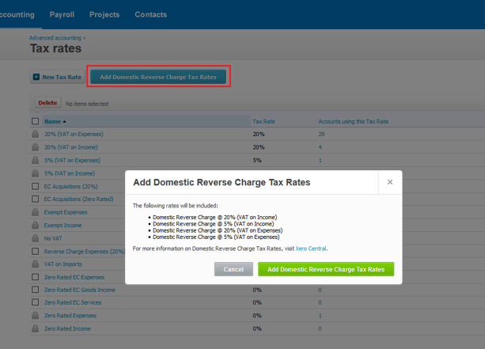
Accounting system entries - Xero
How will it work:
Similar to Sage, Xero will have the core function built in.

Slide 23
VAT reverse charge for construction services
Useful links
To check VAT numbers
https://www.gov.uk/check-uk-vat-number
To check CIS registration
https://www.gov.uk/use-construction-industry-scheme-online
HMRC General Guidance
https://www.gov.uk/guidance/vat-domestic-reverse-charge-for-building-and-construction-services
HMRC Technical Guide
https://www.gov.uk/guidance/vat-reverse-charge-technical-guide#

Slide 24
Richard Taylor
richard.taylor@albertgoodman.co.uk
01823 286 096
TAUNTON BRIDGWATER BURNHAM-ON-SEA CHARD WEDMORE WESTON-SUPER-MARE WEYMOUTH YEOVIL
Notes:
If you would like to discuss any areas of the presentation or R&D in general then feel free to ask questions now or come and see me after.

Slide 25
TAUNTON CHARD WEDMORE WESTON-SUPER-MARE WEYMOUTH YEOVIL

